Slide 1
Internal Styling

Slide 2
Agenda
Internal Styling
Sample output
Implementation of Internal styling

Slide 3
Internal Styling
Internal Styling is used to style group of elements at a time.
We can do Internal styling to individual elements also.
We will place all our style attribute in head tag.
We cannot use this style attribute in other web pages.

Slide 4
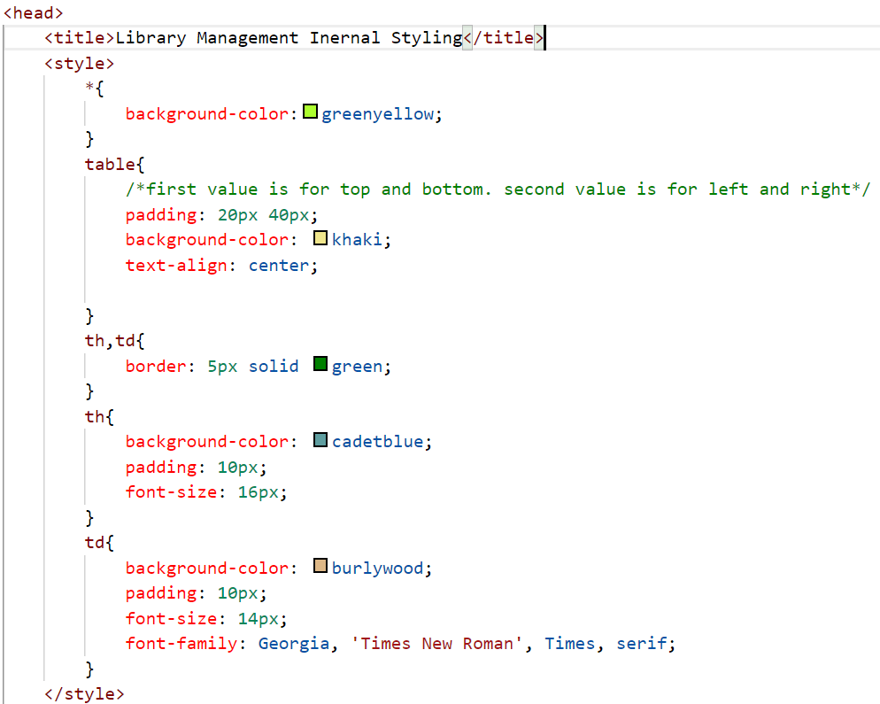
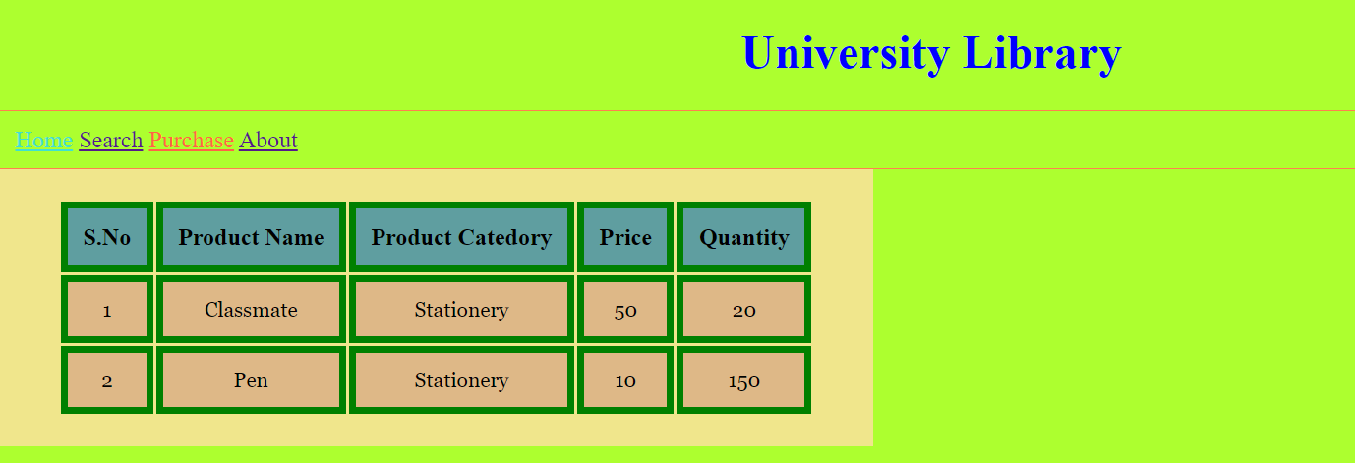
Sample output

Slide 5
Internal Styling Implementation
Lets see the implementation of Internal Styling.

Slide 6
Summary
Internal style is used to separate the html code and css code in the same file.
We can implement the same style to all the like html tags or individual html tags.
DO NOT WRITE ANYTHING
HERE. LEAVE THIS SPACE FOR
WEBCAM

Slide 7
Thank You
Proprietary content. ©Great Learning. All Rights Reserved. Unauthorized use or distribution prohibited

